Slide 1
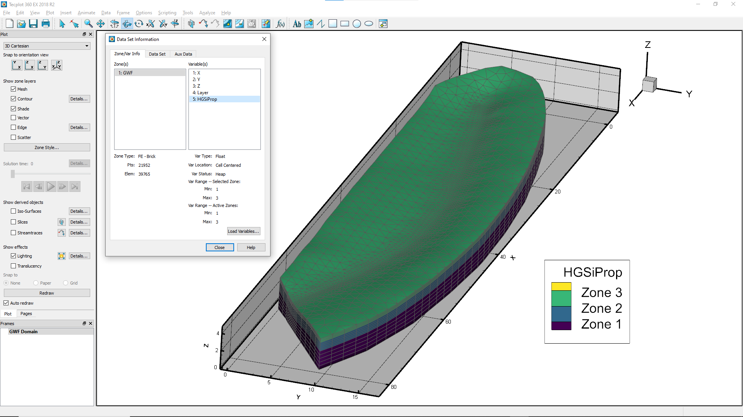

Slide 2
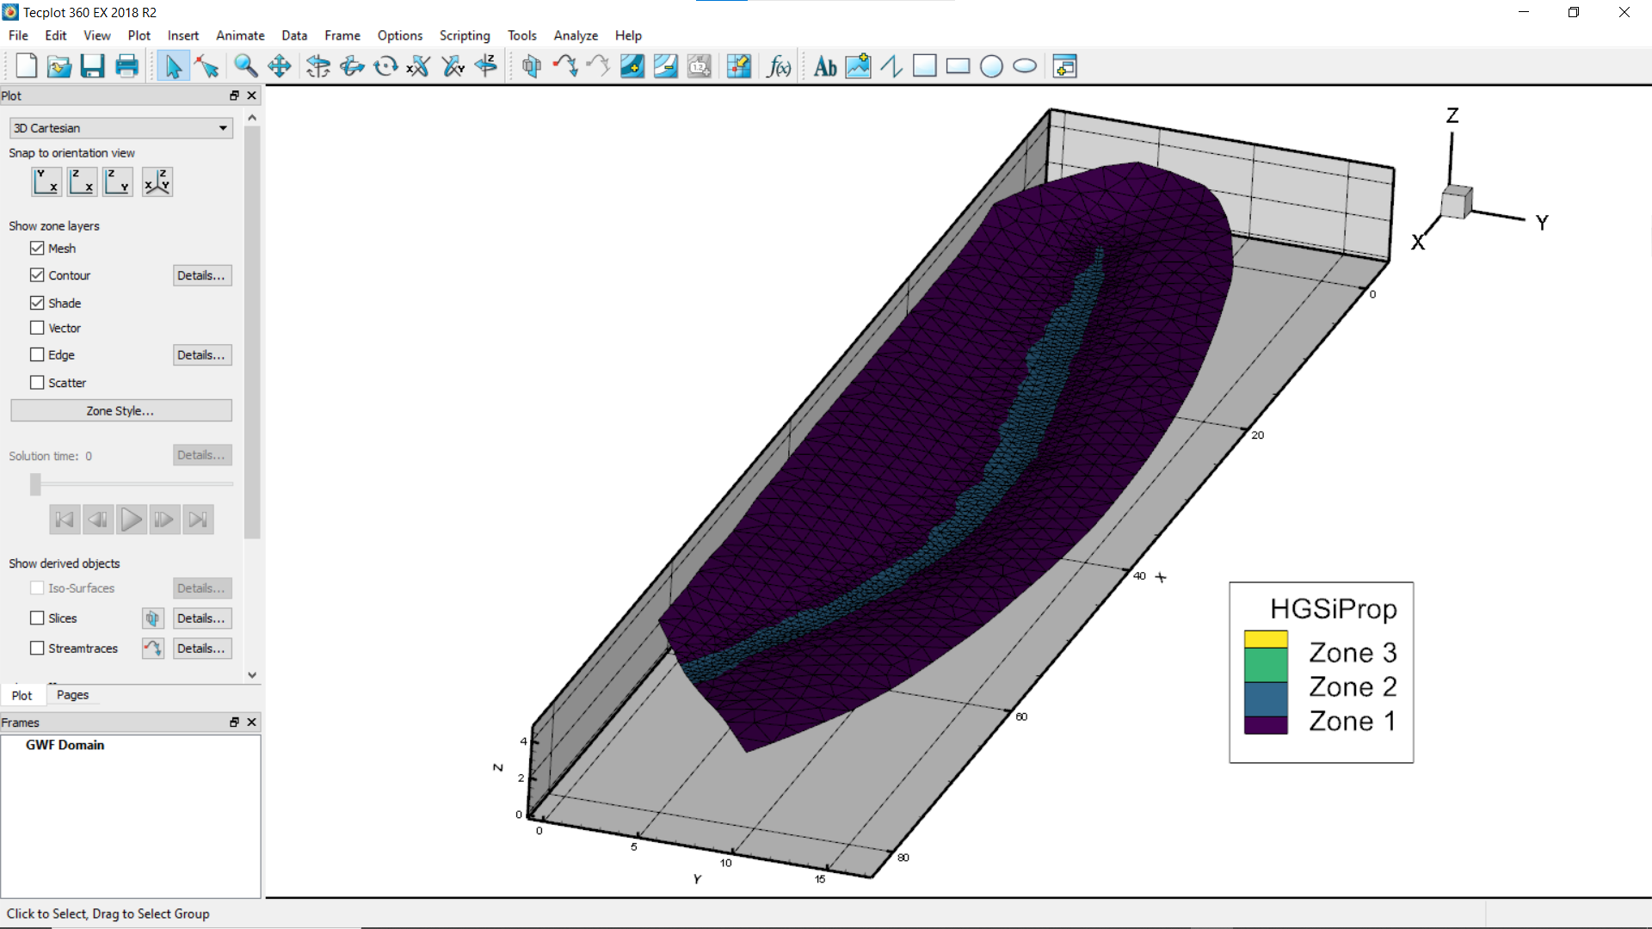

Slide 3
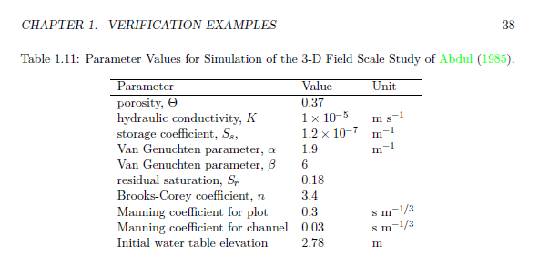
Abdul parameter values from HGS manual hydrosphere_verif.pdf

Slide 4
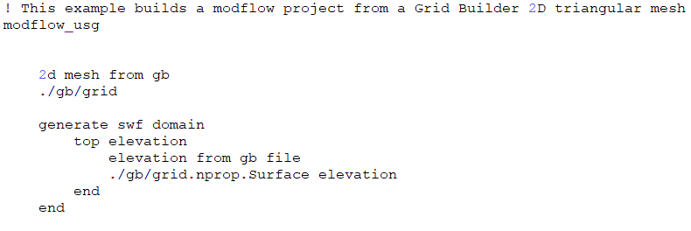
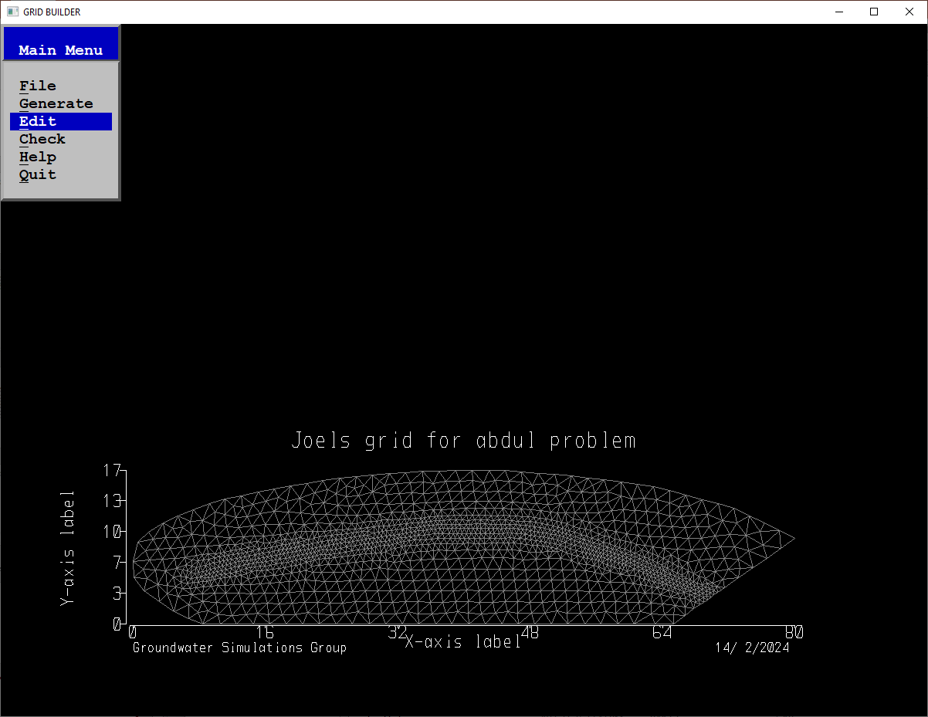
Modflow Project Setup
Define a 2D template mesh which is used to generate SWF and GWF modflow domains.
Here we read an existing Grid Builder triangular mesh.
Generate a SWF domain and define the elevation (z-coordinate)

Slide 5
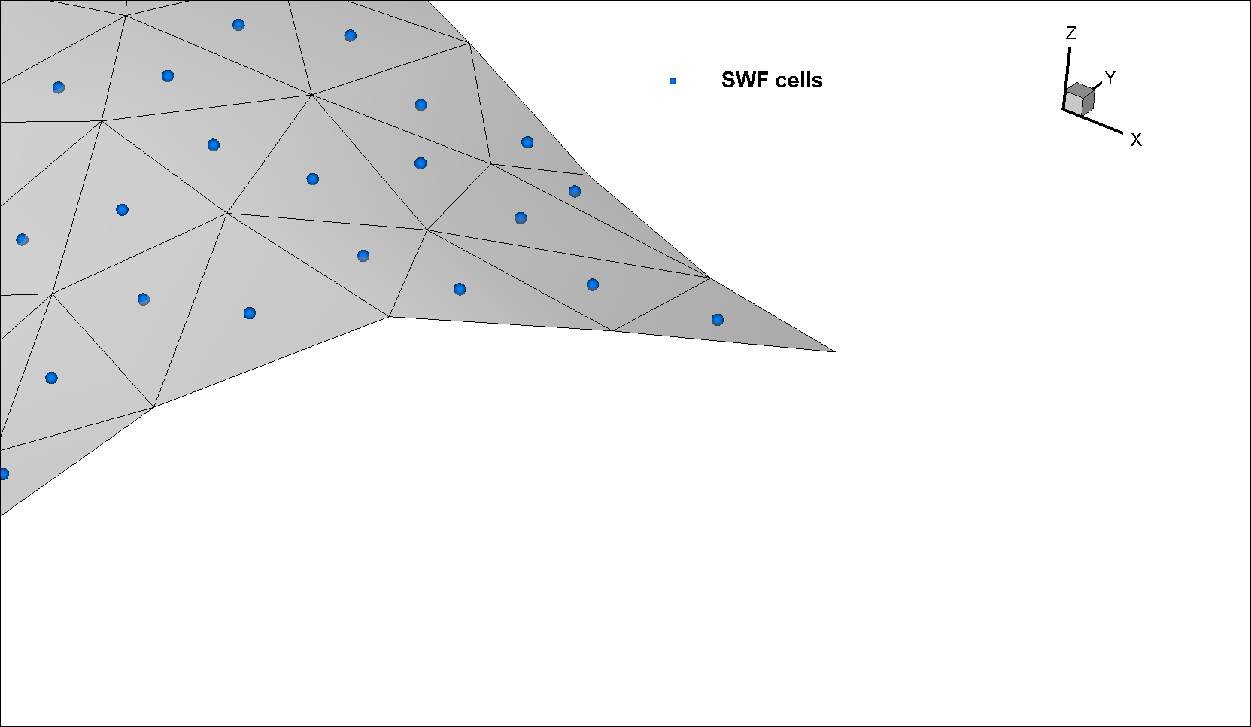
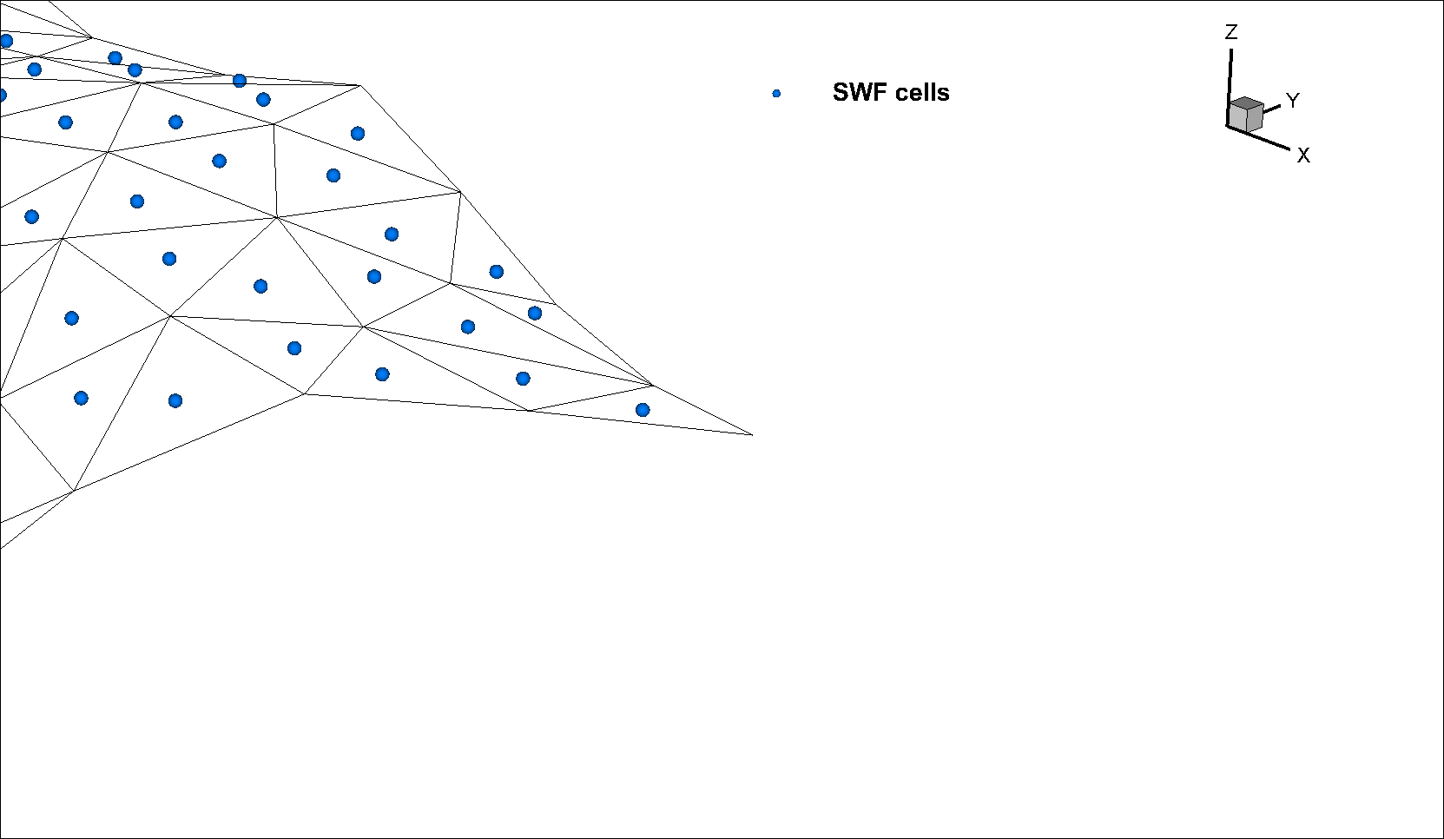
Generate a SWF domain and define the elevation (z-coordinate)

Slide 6
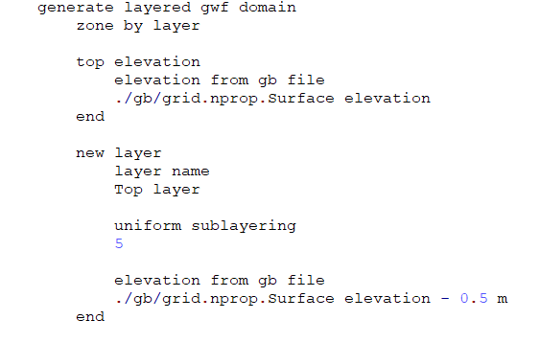
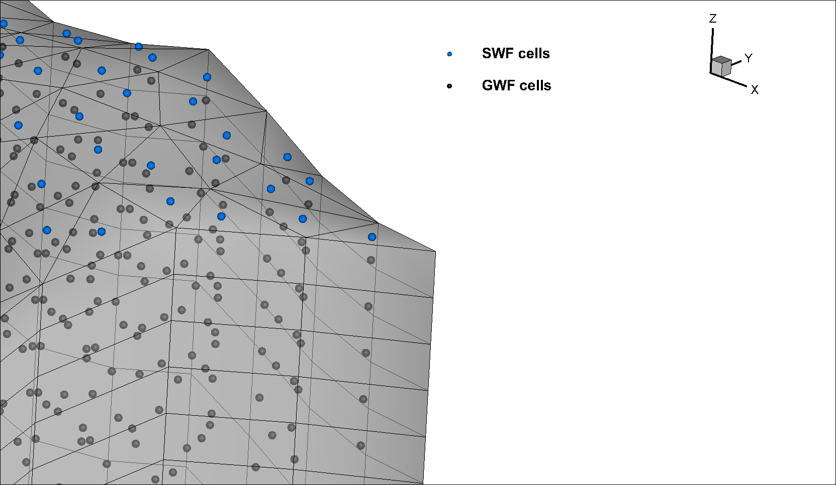
Generate a GWF domain and define the elevations (z-coordinates) of the each layer base

Slide 7
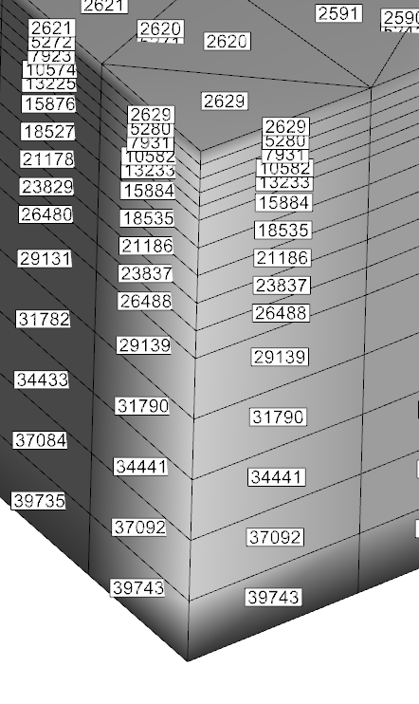
Modflow numbering is from the top down, as shown with cell numbers to the left

